Slide 1
Scalar reality and linguistic categories
Minä ja muut: A scholar in the making
Seminar in celebration of
Marja-Liisa Helasvuo’s 60th birthday
Laura A. Janda

Slide 2
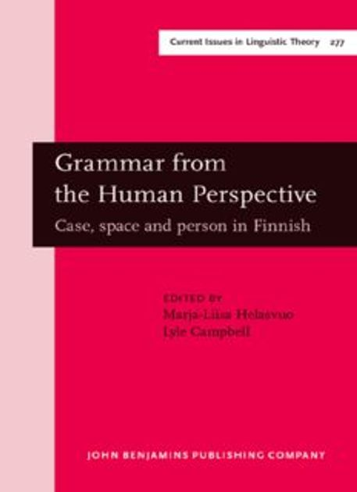
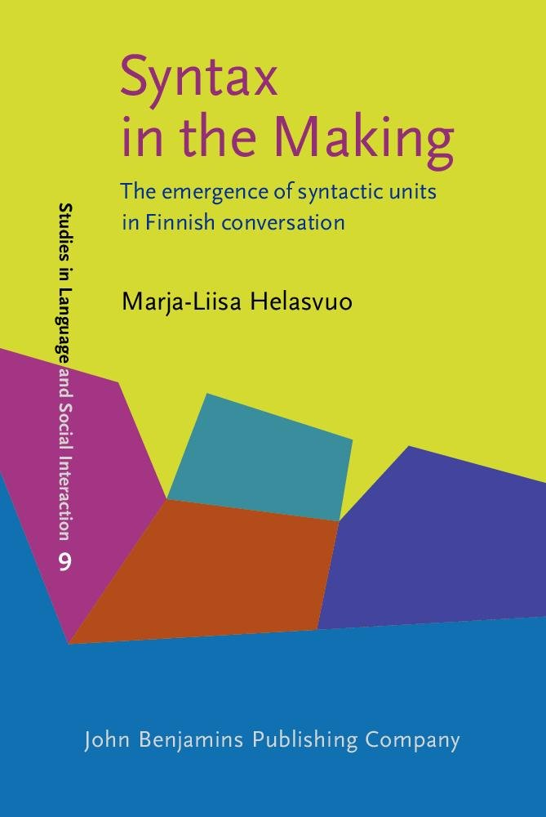
Tension between discreteness and scalarity
Grammar is emergent, “its design is motivated by its use in human interaction” (Laury & Helasvuo 2016)
“[G]rammar codes the subjective viewpoint of human language users” (Helasvuo & Campbell 2006)

Slide 3
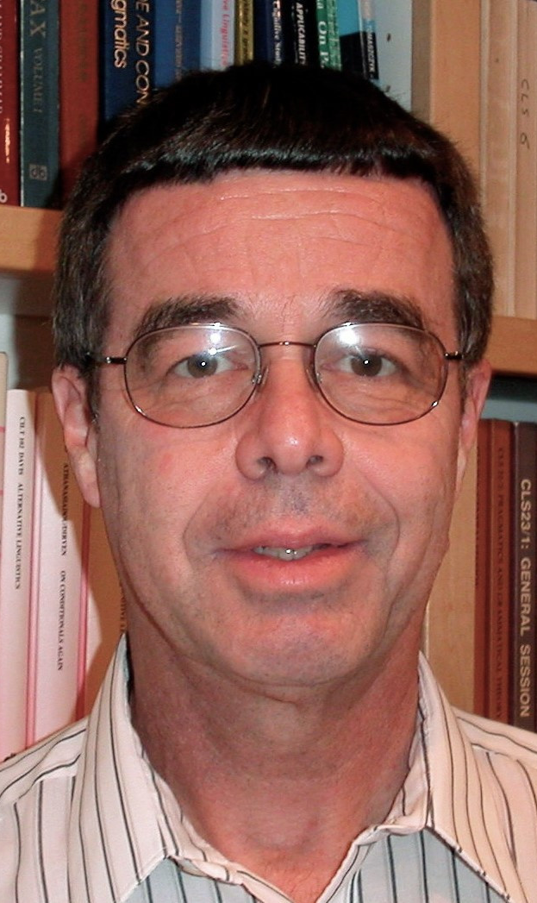
On the continuous debate about discreteness (Langacker 2006)
“The issue of discreteness vs. continuity comes into play in all domains of linguistic analysis and at multiple levels.”
This includes
grammatical categories

Slide 4
Scalarity in discrete grammatical categories: Two case studies
Singular vs. Plural
Correspondence analysis of the gramatical profiles of nouns
Most salient is SING vs. PL
Scale from most singular to most plural
Perfective vs. Imperfective
Correspondence analysis of the grammatical profiles of verbs
Most salient is PFV vs. IPFV
Scale from most perfective to most imperfective
The language has binary categories, but the community of speakers uses them to describe a continuous reality

Slide 5

What is a grammatical profile?
Inflected words have different forms:
eat 749 M
eats 121 M
eating 514 M
eaten 88.8 M
ate 258 M
The grammatical profile of eat
(a constructed example)
Notes:
Figures from google – this is NOT a scientific way to do grammatical profiles, but it gives us a rough approximation to illustrate

Slide 6
What is correspondence analysis?
A way to identify relationships among variables
Input is a matrix of numerical values
For example, a file with grammatical profiles where each word is a row, each column is a grammatical category, and each cell represents the frequency of the given word in the given category
Measurement of the mathematical distance between each row and each column in a hypothetical multidimensional space
Each dimension is called a “factor”
“Factors” are ordered from most to least important
Two most important factors define X and Y axis on a plot

Slide 7
Case Study 1: Singular vs. Plural

Slide 8
Data from SynTagRus, a “gold standard” (manually annotated) corpus of about 1M words
Grammatical profiles of 95 masculine animate nouns attested ≥50 times
freq | lemma | gramm | total | sg.nom | sg.gen
2651 | человек | Masc.Anim | 2651 | 14.79 | 14.22
This means that 2651 forms of the word человек ‘person’ appear in the corpus, and that 14.79% of them are Nominative Singular forms, 14.22% are Genitive Singular forms, etc. There are ten more columns for all of the case + number combinations.

Slide 9
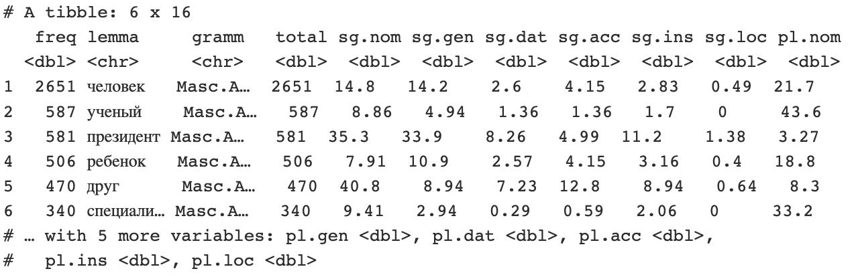

Slide 10
Masculine animates

Slide 11
Typically a lexeme is found in only 1-3 wordforms
Masculine animates

Slide 12
Typically a lexeme is found in only 1-3 wordforms
The typical wordforms
are motivated by constructions
Masculine animates

Slide 13
Typically a lexeme is found in only 1-3 wordforms
NomPl аналитики отмечают
‘analysts make the point that’
The typical wordforms
are motivated by constructions
InsSg стать/быть чемпионом
‘become/be the champion’
Masculine animates

Slide 14
Masculine animates
Factor 1 looks like number:
<- singular vs. plural ->

Slide 15
The extremes
Very singular nouns
korrespondent ‘correspondent’
direktor ‘director’
doktor ‘doctor’
ded ‘grandfather’
načal’nik ‘boss’
prezident ‘president’
otec ‘father’
prem’er-ministr ‘prime minister’
Very plural nouns
analitik ‘analyst’
kitaec ‘Chinese’
medik ‘physician’
amerikanec ‘American’
russkij ‘Russian’
talib ‘Taliban’
voennoslužaščij ‘soldier’
založnik ‘hostage’
bosses and relatives
ethnonyms and groups

Slide 16
Case Study 2: Perfective vs. Imperfective

Slide 17
Grammatical Profiles of Russian Verbs Bottom-Up
Data extracted from the manually disambiguated Morphological Standard of the Russian National Corpus (approx. 6M words), 1991-2012
Stratified by genre, 0.4M word sample for each
Genre | # Verb Tokens | # Verb Lemmas | # Verb Lemmas Frequency >50
Journalistic | 52,716 | 5,940 | 185
Fiction | 78,084 | 8,665 | 225
Scientific-Technical | 43,528 | 4,494 | 172
We will look only at Journalistic data

Slide 18
Correspondence Analysis of Journalistic Data
Input: 185 vectors (1 for each verb) of frequencies for verb forms
Each vector tells how many forms were found for each verbal category: indicative non-past, indicative past, indicative future, imperative, infinitive, non-past gerund, past gerund, non-past participle, past participle
rows are verbs, columns are verbal categories
Process:
Matrices of distances are calculated for rows and columns and represented in a multidimensional space defined by factors that are mathematical constructs. Factor 1 is the mathematical dimension that accounts for the largest amount of variance in the data, followed by Factor 2, etc.
Plot of the first two (most significant) Factors, with Factor 1 as x-axis and Factor 2 as the y-axis
You can think of Factor 1 as the strongest parameter that splits the data into two groups (negative vs. positive values on the x-axis)

Slide 19

On the Following Slide…
Results of correspondence analysis for Journalistic data
Perfective verbs represented as “p”
Imperfective verbs represented as “i”
Remember that the program was not told the aspect of the verbs
All it was told was the frequency distributions of grammatical forms
All it was asked to do was to construct the strongest mathematical Factor that separates the data along a continuum from negative to positive (x-axis)

Slide 20
Perfective
Imperfective
Factor 1 looks like aspect

Slide 21
Factor 1 correctly predicts aspect 91.3% (negative = perfective vs. positive = imperfective)
Of the 185 verbs:
87 perfectives
84 negative values, 3 positive values, so 96.6% correct
3 deviations are: obojtis’ ‘make do without’, smoč’ ‘manage’, prijtis’ ‘be necessary’
96 imperfectives
83 positive values, 13 negative values, so 86.5% correct
13 deviations are: ezdit’ ‘ride’, rešat’ ‘decide’, xodit’ ‘walk’, prinimat’ ‘receive’, iskat’ ‘seek’, rassčityvat’ ‘estimate’, provodit’ ‘carry out’, ožidat’ ‘expect’, borot’sja ‘struggle’, platit’ ‘pay’, čitat’ ‘read’, učastvovat’ ‘participate’, smotret’ ‘look’
2 biaspectuals with low negative values
obeščat’ ‘promise’, ispol’zovat’ ‘use’

Slide 22
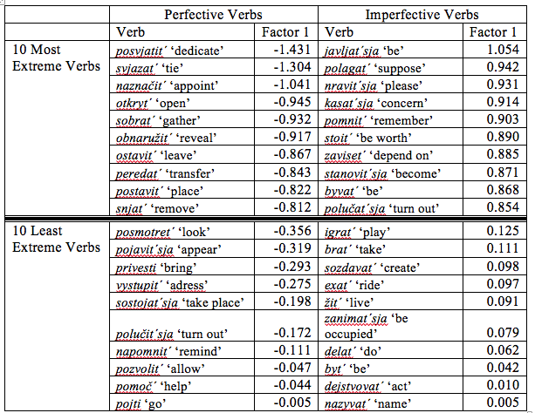

Slide 23
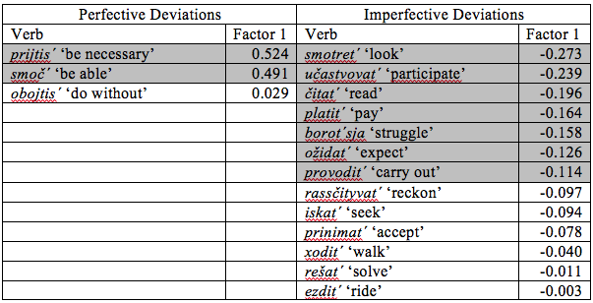

Slide 24
Conclusions
Language has discrete categories
Singular vs. Plural
Perfective vs. Imperfective
Reality is complex and continuous
The community of speakers deploy discrete categories in scalar fashion

